Slide 1
Digital image processing
Metin Akif Zehir - 21290608
Bilal Emre Durmuş - 22290753

Slide 2
Select an image
Our program is able to ask user to select image when user clicks the Select File button.
After the selection, program automatically shows the image on the screen.

Slide 3
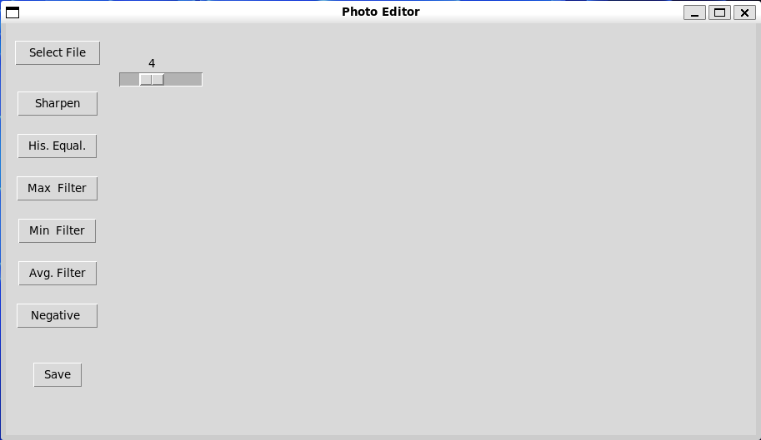

Slide 4
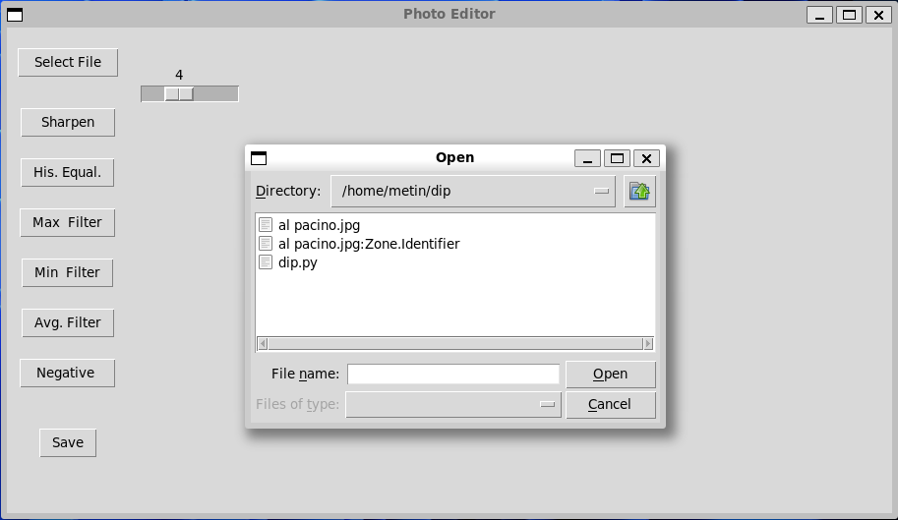

Slide 5
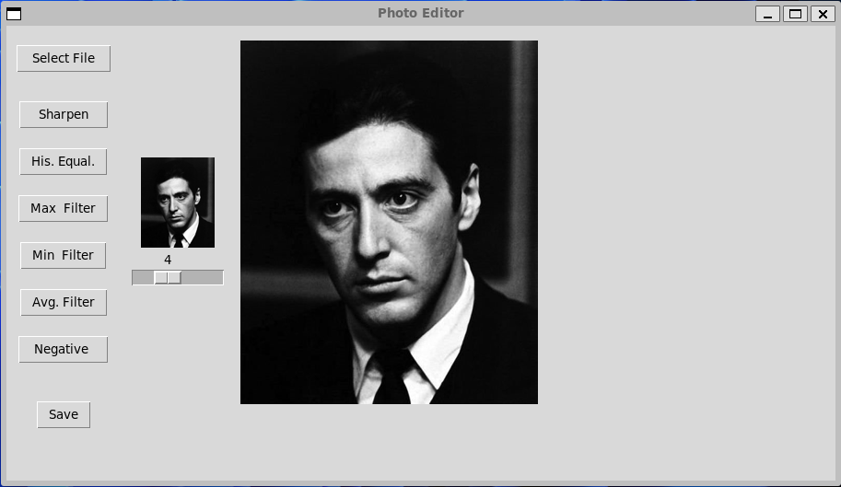

Slide 6
Applying filter
Our program is able to six different filter on the original image:
Sharpening
Histogram Equalization
Minimum Filter
Maximum Filter
Average Filter
Negative of the image
There is a slider for min, max and average filter`s size.
Also, user can save the modified image as jpg file.

Slide 7

sharpening

Slide 8
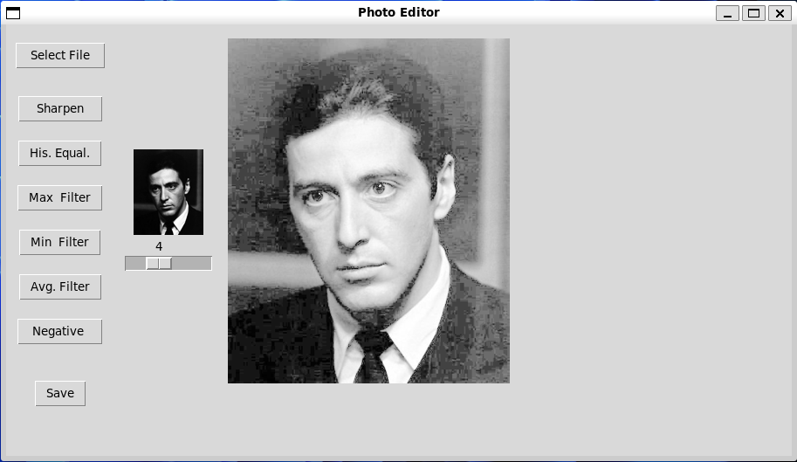
Histogram equalization

Slide 9
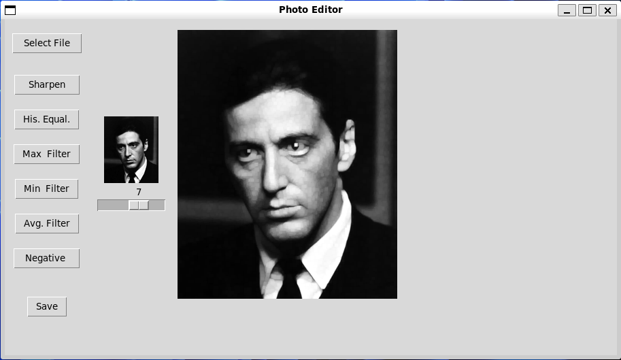
Maximum filter

Slide 10

Minimum filter

Slide 11

Average filter

Slide 12
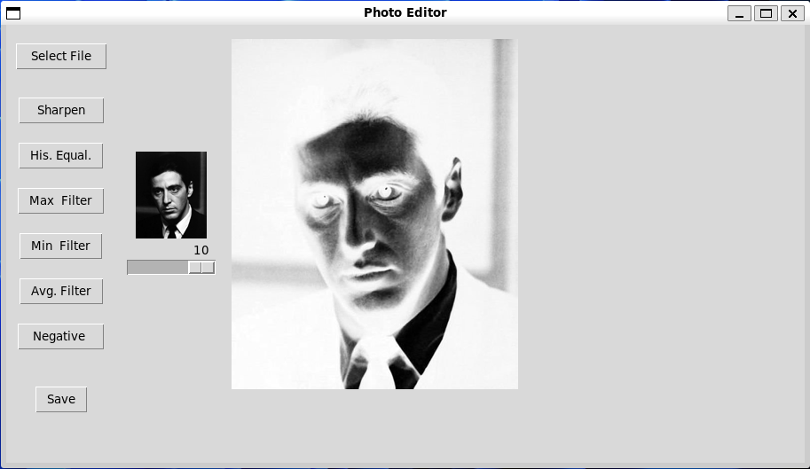
negative

Slide 13
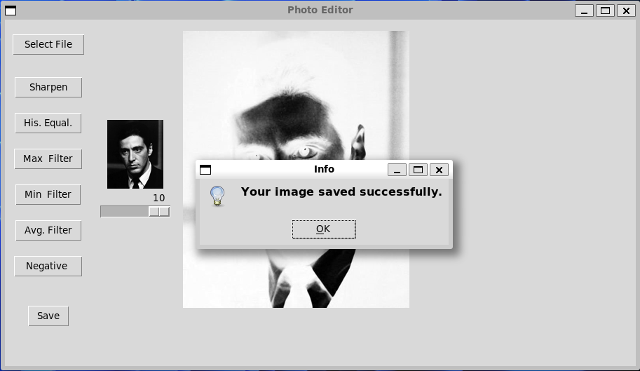
Info box after saving image

Slide 14
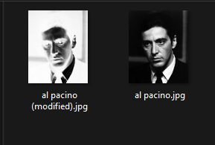
Saved as jpg file

